Slide 1
DEEP LEARNING CAPSTONE
CIFAR-10 with
Dense Networks Only
How far can a fully connected network see, with no convolution allowed?
3,072
20
54.08%
59.12%
inputs per image
experiments
test accuracy
best with augmentation
Khalid - Wasan
Building & Developing AI Models Bootcamp

Slide 2
One rule shapes everything
No CNN, no Conv2D, no pretrained weights, no transfer learning
The task
The rule
What that costs
CIFAR-10, ten mutually exclusive classes
60,000 colour images at 32 x 32 x 3
Softmax output, sparse categorical
cross-entropy loss
Dense layers only
Every image must be flattened before
it reaches the first layer
32 x 32 x 3 becomes 3,072 x 1
One weight per pixel position
No translation invariance: shift an
object three pixels and almost every
input value changes
The network must learn the same
object again
That single decision sets the ceiling for every experiment that follows.

Slide 3
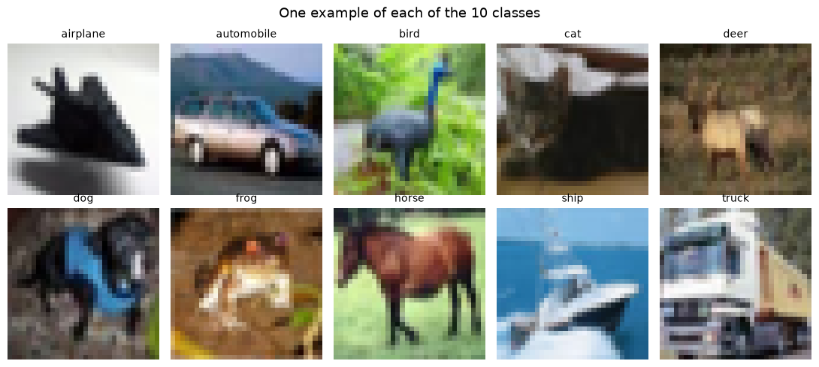
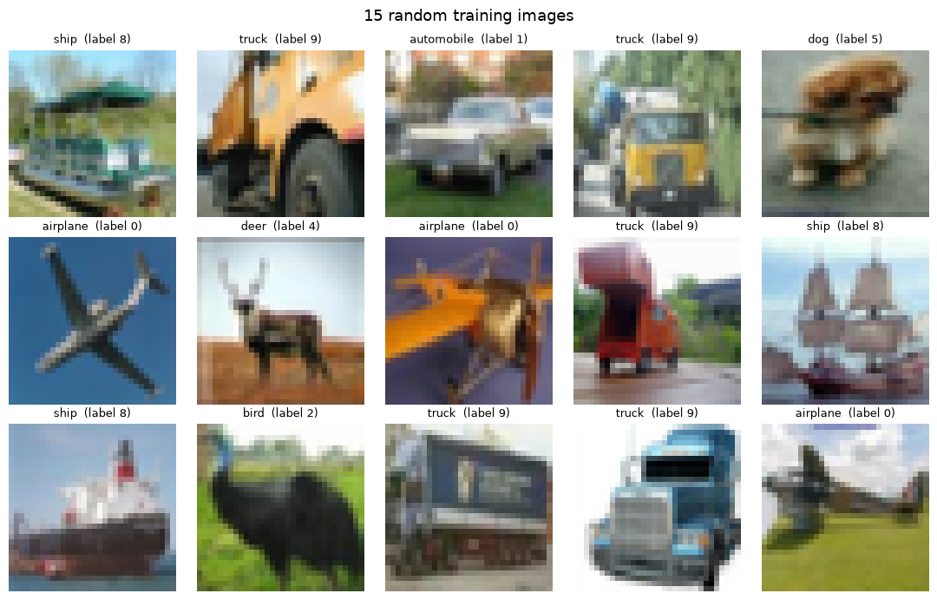
The data
One row is one 32 x 32 colour image, ten balanced classes
One example of each class
Fifteen random training images
Ten mutually exclusive classes at 32 x 32 pixels. At this resolution the animal classes already look alike.

Slide 4
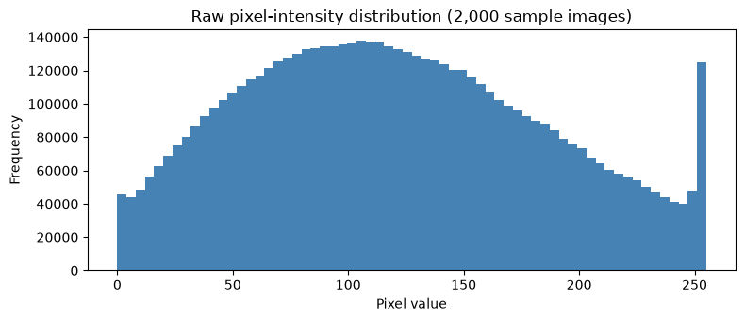
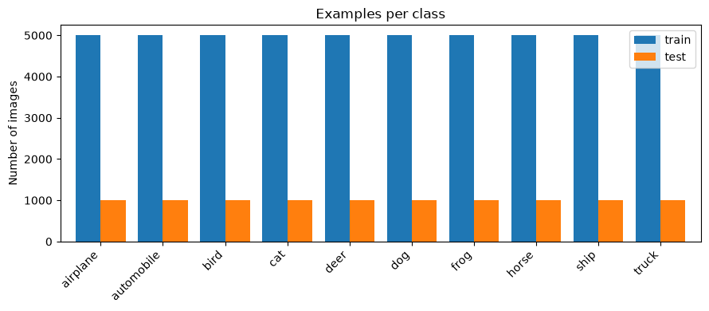

Preparation
Scaled, split once, and committed so every experiment shares it
The split
45,000 train
5,000 validation, stratified
10,000 test, untouched until Part 16
Pixels scaled to [0, 1]
Indices saved to splits.npz and
committed to git
Exactly 6,000 images per class
The test set is opened once, at the very end. Every tuning decision is made on validation only.

Slide 5
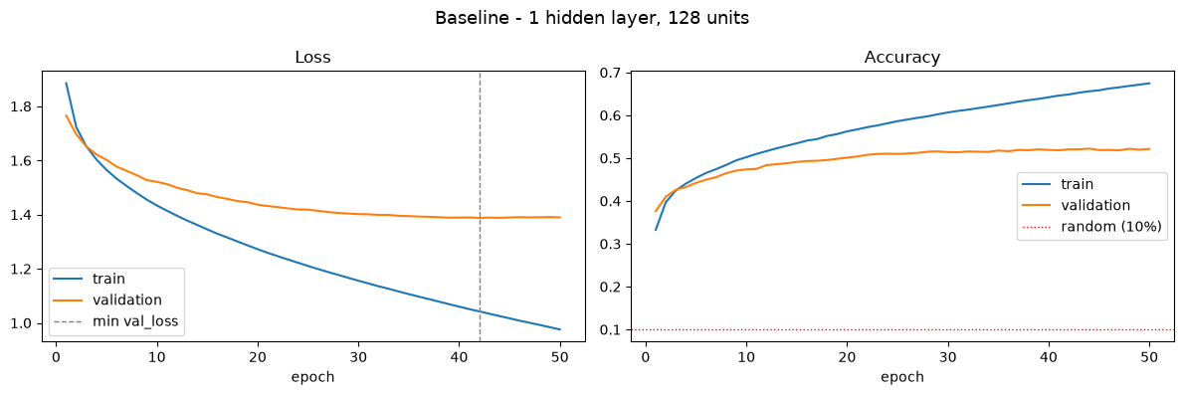
Part 3 - The baseline
One hidden layer, 512 units, Adam at 0.0001, batch 128
1 x 512 ReLU · Adam 0.0001 · batch 128 · 50 epochs · sparse categorical cross-entropy · seed 42
52.22%
best validation accuracy
1,578,506
trainable parameters
About 5x the 10% random-guess floor, and 99.7% of those parameters sit in the very first layer.

Slide 6
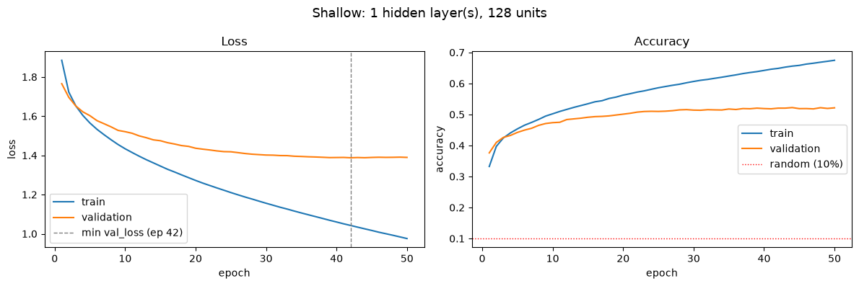
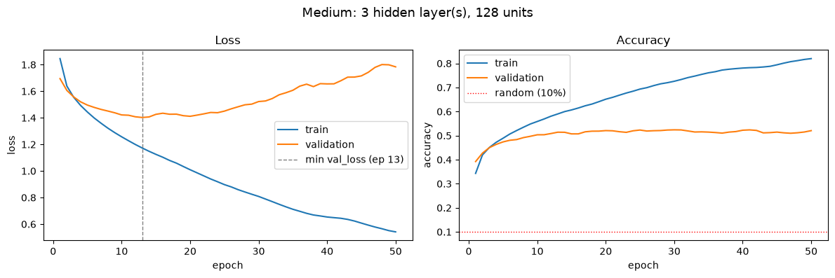
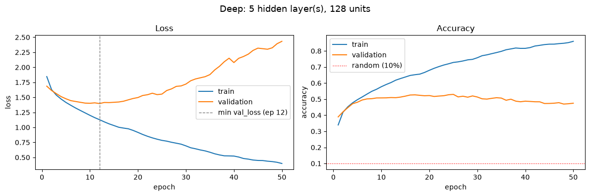
Parts 4-6 - Three depths, one width
Same data, same seed, same hyperparameters, only depth changes
Shallow 1 x 512 · Medium 3 x 512 · Deep 5 x 512 · all: ReLU, Adam 0.0001, batch 128, 50 epochs, no regularization, seed 42
Shallow 1 x 512
Medium 3 x 512
Deep 5 x 512
52.22% gap 0.15
52.40% gap 0.30
52.98% gap 0.33
Depth barely moves validation accuracy, but it steadily widens the gap between training and validation.

Slide 7
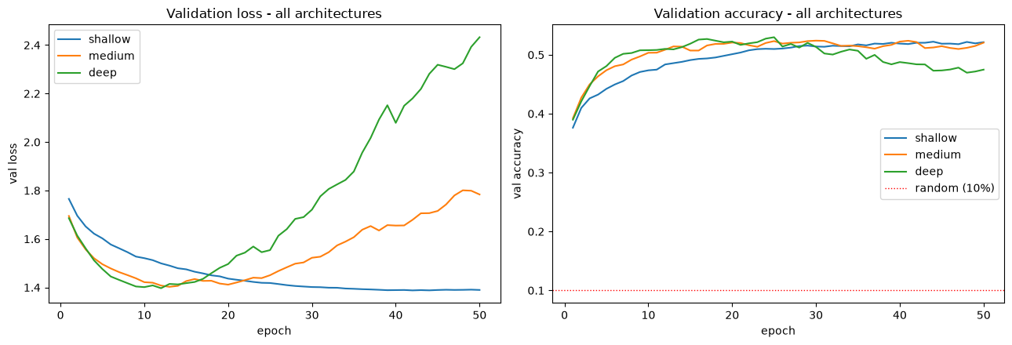
Part 7 - The comparison
All three land within 38 images of each other
Shallow 1 x 512 · Medium 3 x 512 · Deep 5 x 512 · all: ReLU, Adam 0.0001, batch 128, 50 epochs, no regularization, seed 42
52.22%
Shallow gap 0.15
52.40%
Medium gap 0.30
52.98%
Deep gap 0.33
0.76 points apart on a 5,000-image validation set is inside the noise. Depth bought overfitting, not accuracy.

Slide 8
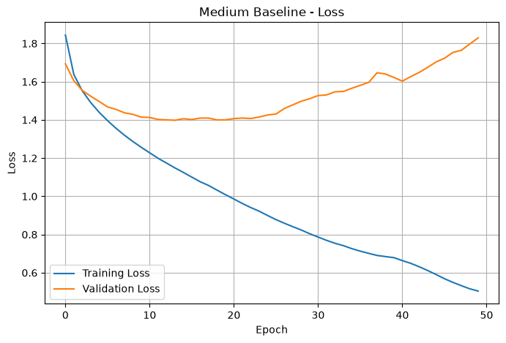
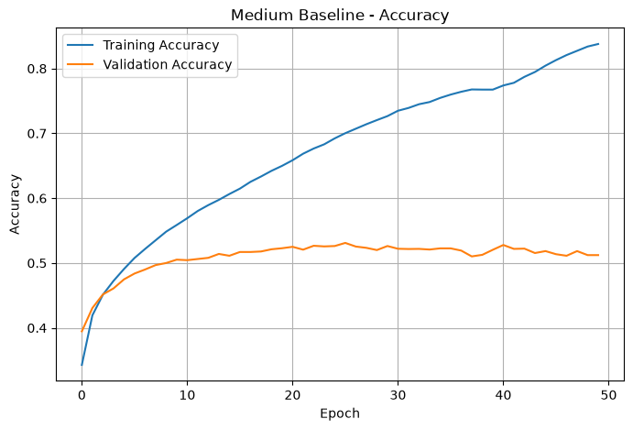
Part 8 - The diagnosis
Medium, 3 x 512, 2,103,818 parameters
3 x 512 ReLU · Adam 0.0001 · batch 128 · 50 epochs · no regularization · seed 42
Overfitting, from epoch 13
Training loss falls all 50 epochs,
1.845 to 0.542
Validation loss bottoms at 1.4024
then rises 27% to 1.7835
Training accuracy reaches 0.820
and is still climbing
Fix: Early Stopping, best
weights restored
The gap widens from 0.0759 at the best epoch to 0.2993 by epoch 50.

Slide 9
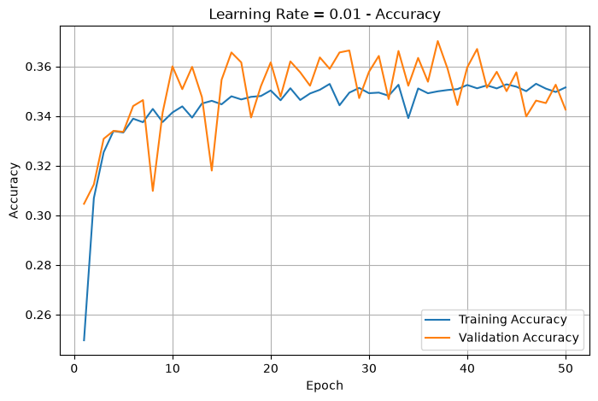
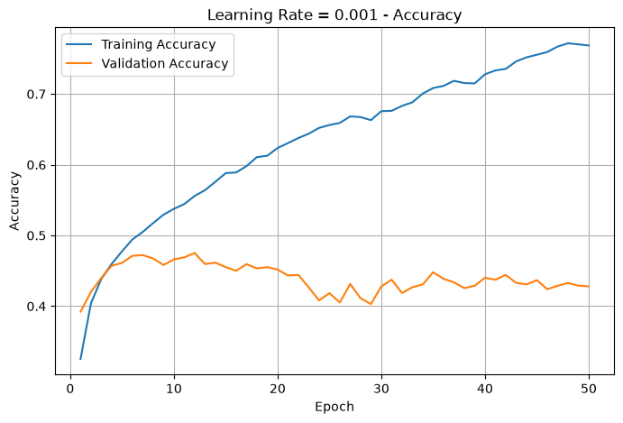
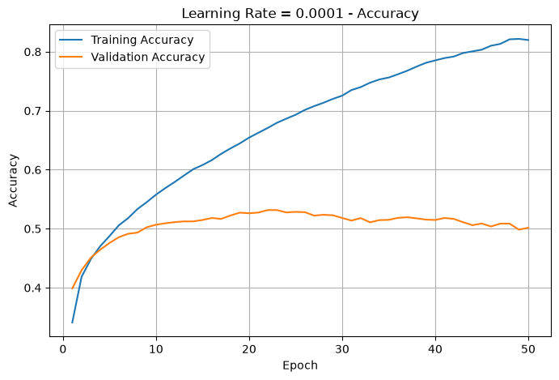
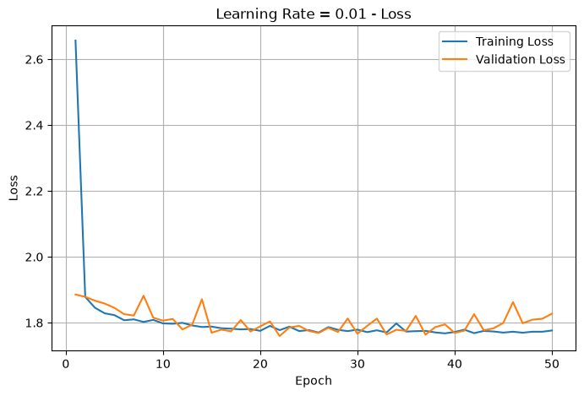
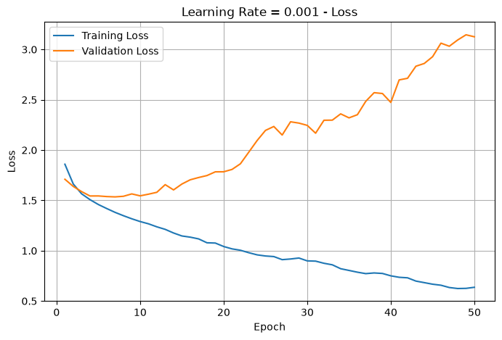
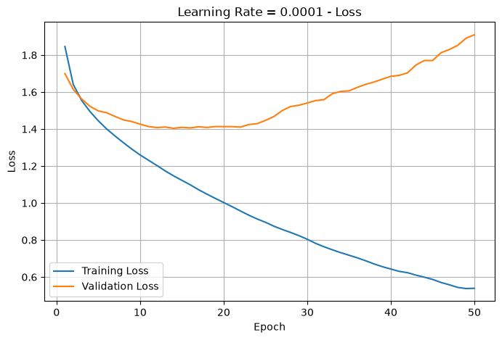
Part 9 - Learning rate
0.01 / 0.001 / 0.0001, everything else held fixed
Varied: learning rate 0.01 / 0.001 / 0.0001 · Fixed: 3 x 512 ReLU, Adam, batch 128, 50 epochs
0.01 -> 38.64%
0.001 -> 47.68%
0.0001 -> 52.64%
0.0001 wins on both accuracy and loss. At 0.001 the model peaks by epoch 12 then diverges to a loss of 2.87.

Slide 10
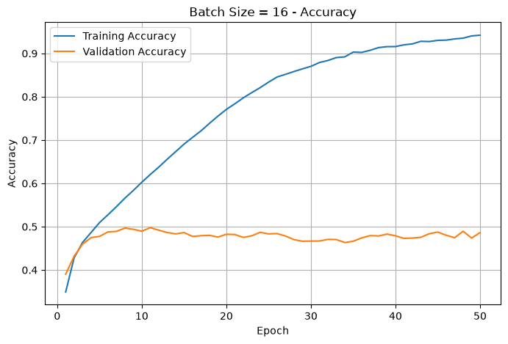
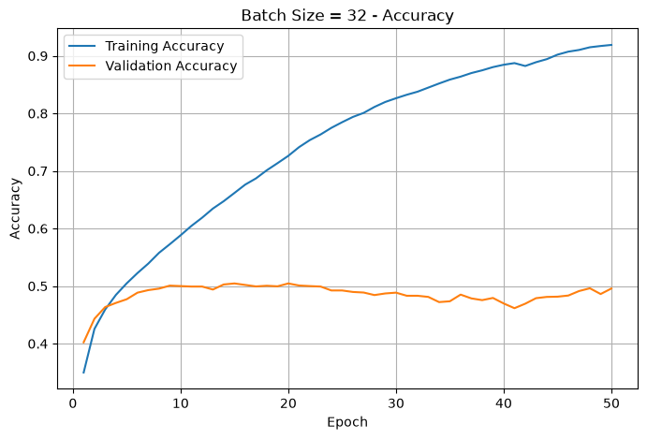
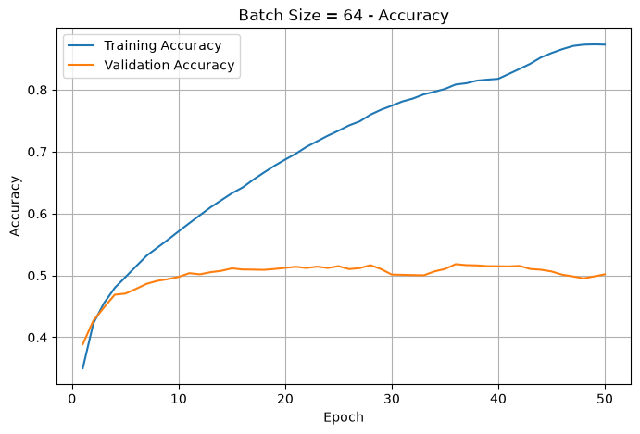
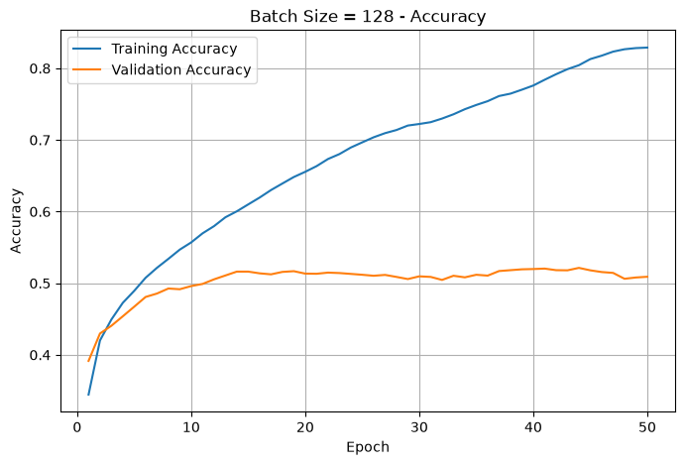
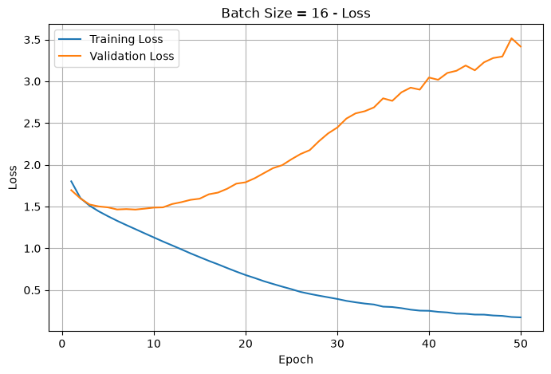
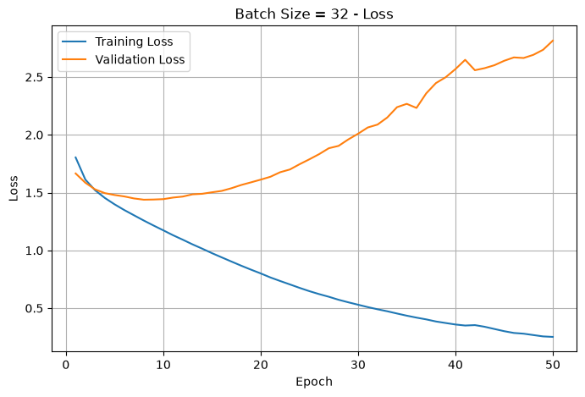
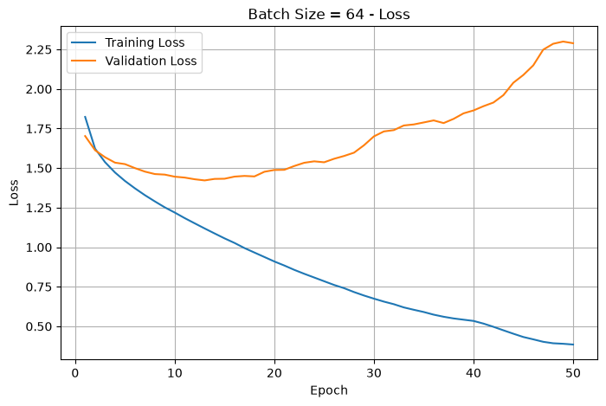
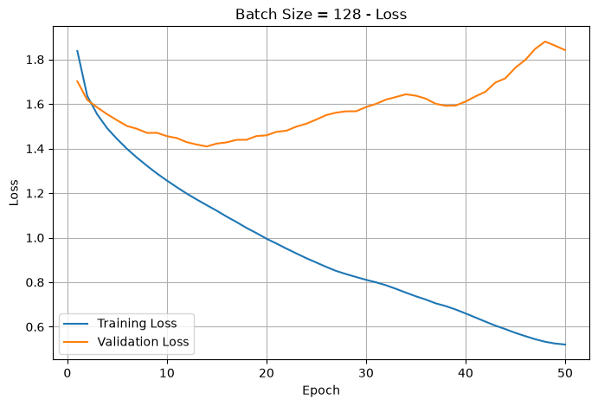
Part 10 - Batch size
16 / 32 / 64 / 128 at the selected learning rate
Varied: batch size 16 / 32 / 64 / 128 · Fixed: 3 x 512 ReLU, Adam 0.0001, 50 epochs
16 -> 50.58%
32 -> 50.92%
64 -> 52.04%
128 -> 52.52%
Accuracy improved at every step. Batch 16 reached 94% training accuracy and a validation loss of 3.42.

Slide 11
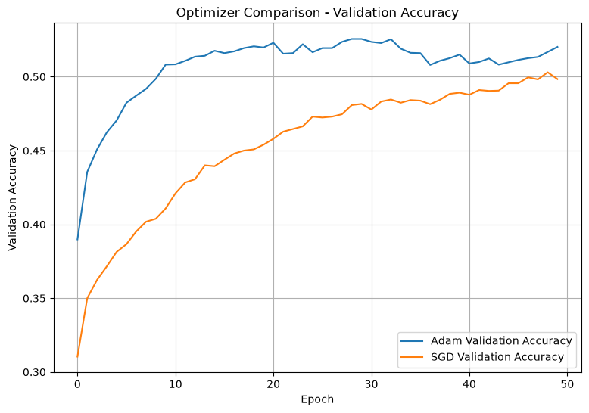
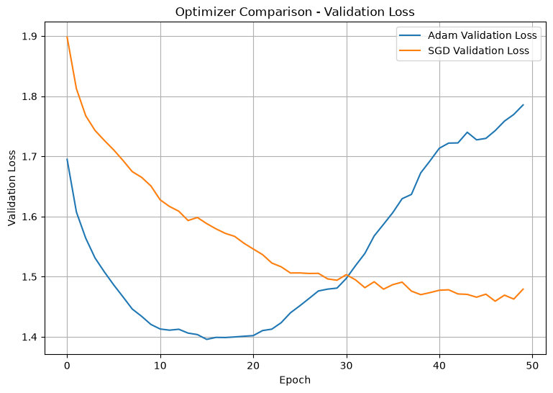
Part 11 - Optimizer
Adam at 0.0001 against SGD at 0.01
Varied: Adam 0.0001 vs SGD 0.01, no momentum · Fixed: 3 x 512 ReLU, batch 128, 50 epochs
Adam wins
52.78% against 49.28%
Min val loss 1.3932
against 1.4807
Peaks at epoch 31;
SGD is still climbing
at epoch 50
The learning rates differ on purpose: Adam normalises its steps, so matched rates would cripple SGD.

Slide 12
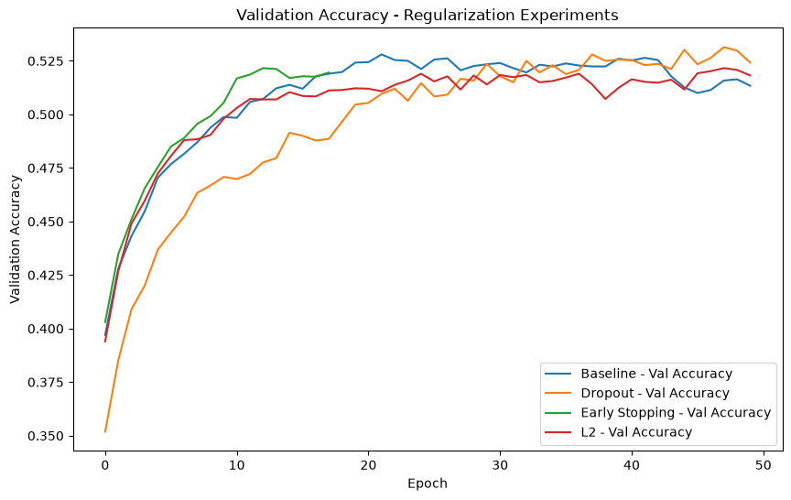
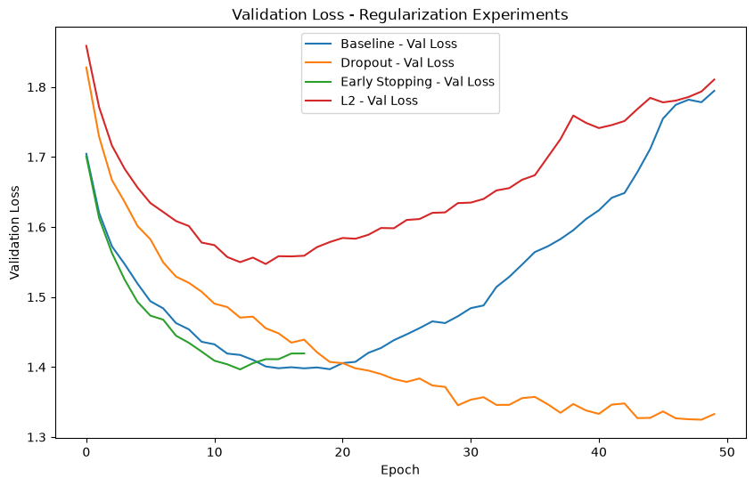
Part 12 - Regularization
Dropout 0.3, Early Stopping and L2 against an unregularized baseline
Varied: none / Dropout 0.3 / EarlyStopping val_loss patience 5 / L2 0.0001 · Fixed: 3 x 512 ReLU, Adam 0.0001, batch 128, 50 epochs
Dropout wins
54.16% accuracy
Gap 32.11% -> 4.47%
Val loss 1.3022,
the lowest of the four
Early Stopping 51.72%
L2 52.30%
Dropout is the only technique that closes the gap rather than trimming it. L2 barely moves it.

Slide 13
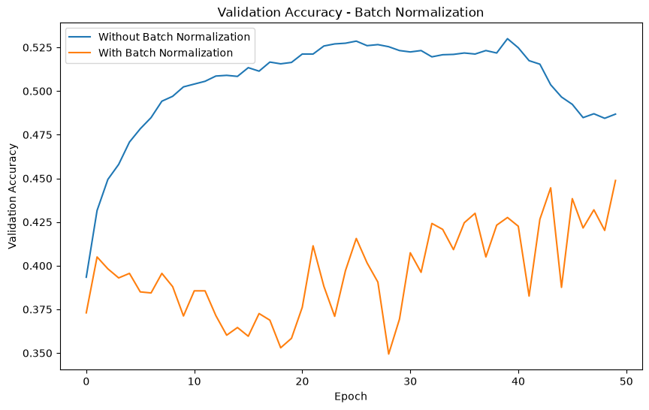
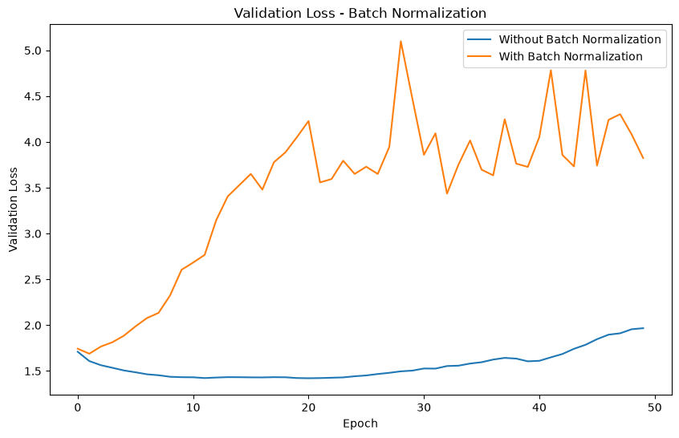
Part 13 - Batch Normalization
The same network, with and without BatchNorm after each Dense layer
Varied: BatchNorm between Dense and ReLU · Fixed: 3 x 512, Adam 0.0001, batch 128, 50 epochs, no Dropout
It backfired
Train 99.20%
Validation 40.70%
Gap 58.50%
Final val loss 4.4448
Best val accuracy fell
from 53.18% to 44.64%
The clearest demonstration in the project that high training accuracy is not evidence of a good model.

Slide 14
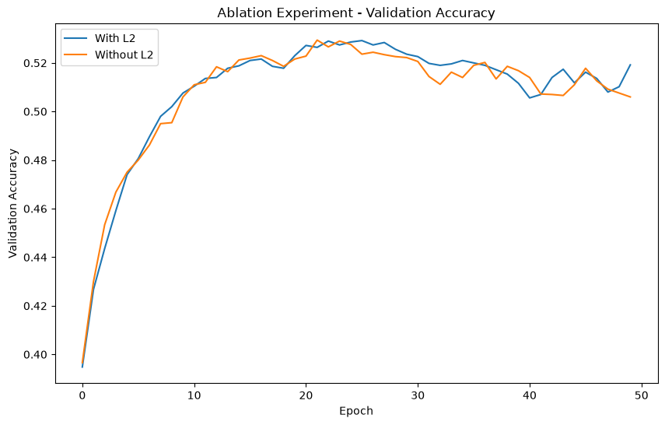
Part 14 - Ablation
One variable removed, everything else identical
Varied: Dropout 0.3 present or absent · Fixed: 3 x 512 ReLU, Adam 0.0001, batch 128, 50 epochs, seed 42
Dropout does the work
Final validation accuracy 54.40% against 51.04%
Gap 4.74% against 30.76%
And the peak as well
Best validation accuracy 54.62% with Dropout,
52.84% without: 89 images out of 5,000
Dropout raises the peak and closes the gap at the same time. It is the regularizer carried into the final model.

Slide 15
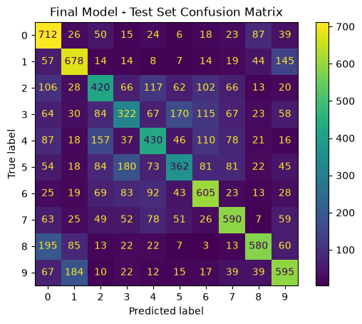
Parts 15-16 - Final model and test
3 x 512, Adam 0.0001, batch 128, Dropout 0.3, Early Stopping
3 x 512 ReLU · Dropout 0.3 · Adam 0.0001 · batch 128 · max 50 epochs, EarlyStopping val_loss patience 5, restore best · seed 42
Per-class F1
ship 0.66 frog 0.59
automobile 0.66 truck 0.59
airplane 0.61 deer 0.47
horse 0.60 dog 0.43
bird 0.43
cat 0.36
54.08%
53.99%
test accuracy
weighted F1
1.2815
2.1M
test loss
parameters
The test set was opened exactly once, after every architecture and hyperparameter decision was final.

Slide 16
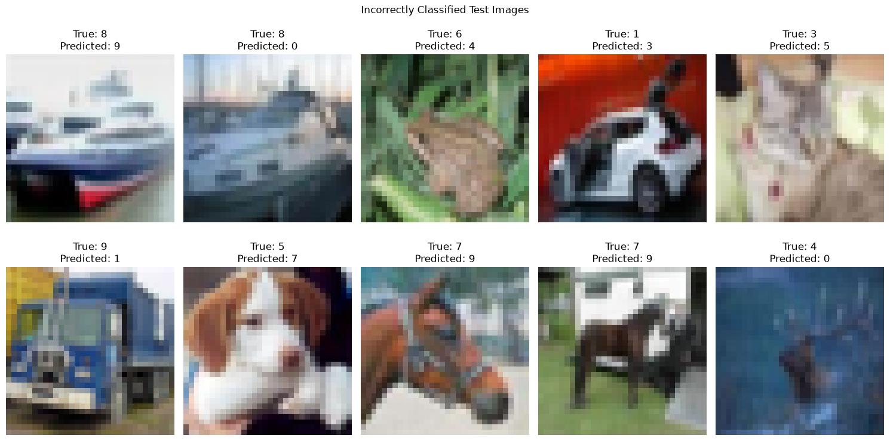
Part 17 - Where it fails
The mistakes are concentrated between visually similar classes
Final model: 3 x 512 ReLU · Dropout 0.3 · Adam 0.0001 · batch 128 · EarlyStopping, best weights restored · seed 42
Hardest
cat 35.96% F1
bird 42.51%
dog 42.82%
Easiest
ship 66.08% F1
automobile 65.58%
airplane 61.38%
Cat and dog account for 383 errors between them, the largest confusion pair in the matrix.

Slide 17
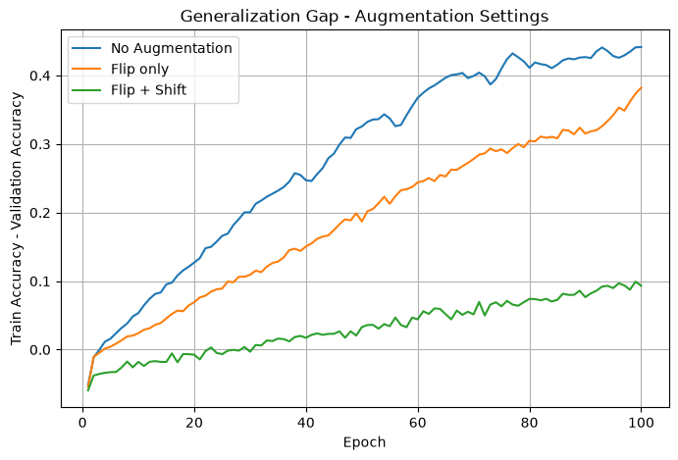
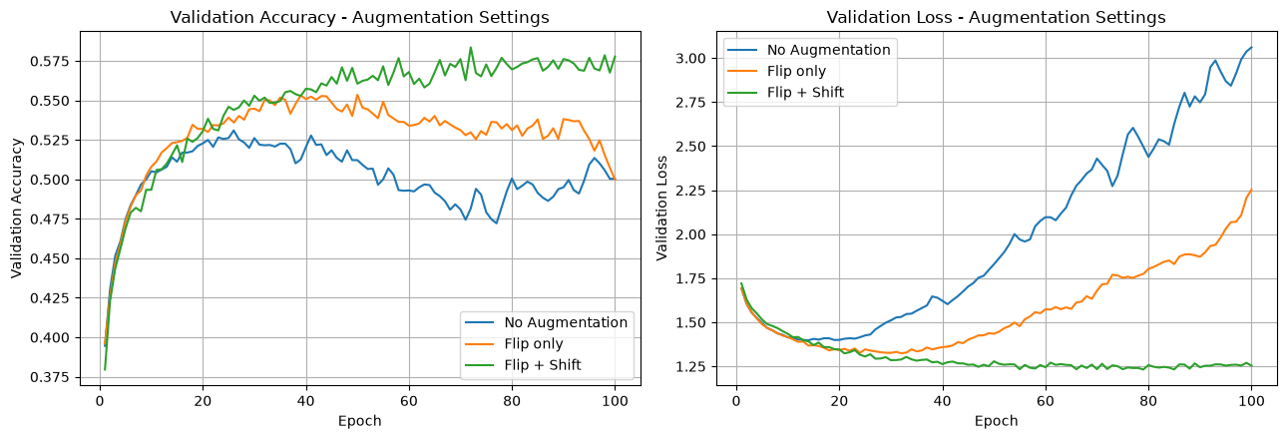
Extra - Data augmentation
Random flip and shift, applied before the image is flattened
Varied: none / RandomFlip horizontal / + RandomTranslation 0.1 · Fixed: 3 x 512 ReLU, Adam 0.0001, batch 128, 100 epochs, seed 42
The biggest gain
No augmentation
52.84%, gap 0.4085
Flip only
54.92%, gap 0.3631
Flip + Shift
59.12%, gap 0.0791
+6.28 points and the gap nearly closed. The strongest single result in the project, and it cost no parameters.

Slide 18
What moved the needle
Six findings that shaped the result
01
02
03
Depth did almost nothing
Width is where the parameters live
Every architecture overfit
0.76 points across 1, 3 and 5 layers
the first layer holds 75% of them
training 82%, validation 52%
04
05
06
Regularization beat architecture
BatchNorm made it worse
Augmentation won outright
Dropout closed the gap 32% to 4%
99.20% train, 40.70% validation
59.12%, the best score recorded
The constraint in the brief mattered more to the final number than any hyperparameter chosen after it.

Slide 19
Part 20 - Why this needs a CNN
The ceiling is architectural, not a tuning failure
What flattening destroys
What that costs
What a CNN gives back
32 x 32 x 3 becomes 3,072 x 1
All pixel values survive, but their
arrangement does not
The model never learns that two
pixels are neighbours
Edges, corners and textures have to
be relearned at every position
A cat three pixels to the left is a
different input vector
This is why cat and dog collapse
into each other
The same filter applied everywhere
Local patterns learned once and
reused across the image
Hierarchical features, from edges
to shapes to objects
Position no longer matters
Our augmentation result points the same way: the fix was more spatial variety, not more parameters.

Slide 20
WHAT WE TOOK AWAY
The architecture set the ceiling,
not the hyperparameters.
Hardest
Best judgement
Next time
telling a real gain from validation-set noise
selecting on the gap once accuracy tied
start with augmentation, not with depth
Thank you
Khalid · Wasan

